Slide 1

Project review Bearing
Cyrus Azamfar
Krishnakumar Chandran
Ravi Teja Telkapally
Siddhartha Patlori

Slide 2
Outline
Background
An overview of analytic steps
Outlier removal – using Grubbs’s test
Outlier removal – using moving window
Envelope Analysis using FFT
Envelope Analysis using Kurtosis Spectral

Slide 3
Overview
Roller element bearings are one of the key components for rotating machinery such as machine tools, motors, gearboxes, turbo machinery etc.
The research interest in developing improvement methods for bearing health monitoring and prognostics is warranted by the prevalent use of bearings and the impact bearing failure has on logistics, maintenance costs and downtime for various applications.

Slide 4
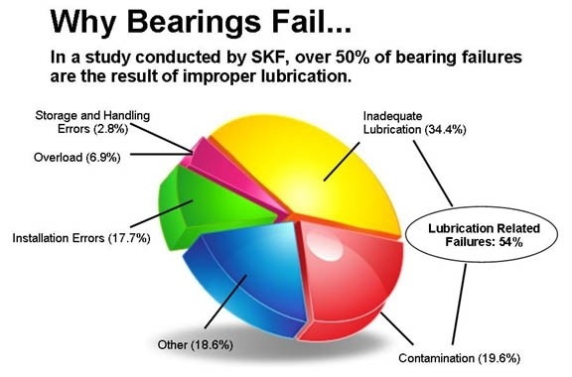

Slide 5
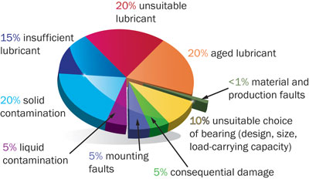
Ways to prevent bearing Failures

Slide 6
Typically used techniques for Bearing health analysis:
Time Waveform Analysis
Frequency Spectral Analysis.
High Frequency Detection
Stress Wave Analysis
Enveloping

Slide 7
BEARING ENVELOPE ANALYSIS-WINDOW SELECTION ERIC BECHHOEFER, MICHAEL KINGSLAY, PRANEET MENON
Bearing envelope analysis (BEA) can typically detect bearing faults 10s if not 100s of hours prior to when it is appropriate to do maintenance.
It is for this reason that many HUMS (Health and Usage Monitoring Systems) manufactures are using envelope analysis techniques.
Bearing Envelope Analysis Frequencies used:
Cage Pass Frequency (CPF), Ball Pass Frequency Outer Race (BPFO), Ball Pass Frequency Inner Race (BPFI), and Ball Fault Frequency (BFF)

Slide 8
Training Data | Testing Data
2048 Tests | 512 Tests
8-Lables | No labels
Fs = 50000; -Sampling rate fr = 800/60; -Spindle's rotating frequency (in Hz) BPFO = 7.14*fr; -outer defect freq.(in Hz) BPFI = 9.88*fr; - inner BSF = 5.824*fr; - roller

Slide 9
Process
Raw Data
Pre processing
Training data
Testing data
Feature Extraction
Feature Extraction
Training features
Testing features
Unsupervised modelling
Global health model and health limits
Health assessment

Slide 10
Pre Processing
Handle missing values
Removing outliers
Correct inconsistent data
Normalization

Slide 11
Splitting the Data
Training data (70%)
For training the model (75% of training)
For Cross validation (25% of training)
Testing data (30%)

Slide 12
Feature Extraction
Time domain features
Mean, Variance, Skewness, Kurtosis, RMS, Peak to Peak
Frequency domain features
Amplitudes of 1st harmonics, 2nd harmonics, 3rd harmonics

Slide 13
Feature Selection
Fisher criterion
Principle Component analysis

Slide 14
Learning Models
Support Vector Machines
Self-Organizing maps
Deep Learning

Slide 15
Cross Validation
K-fold cross validation

Slide 16
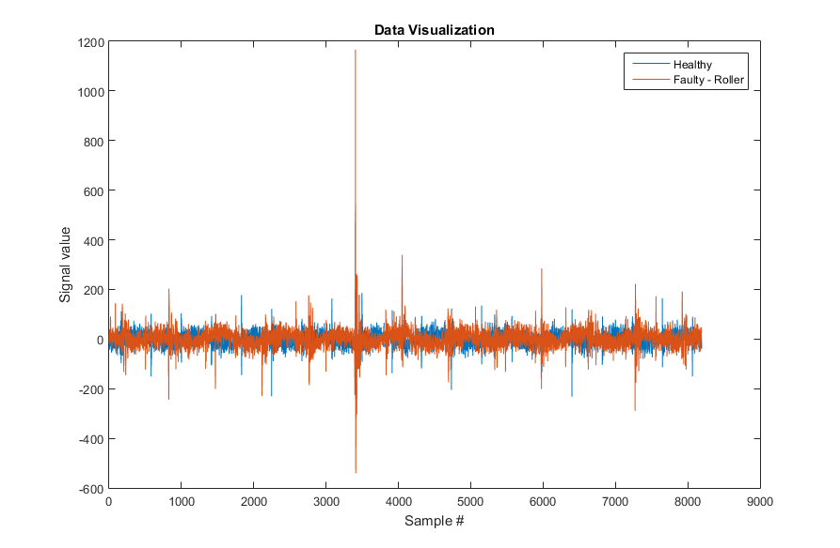
Data VISUALIZATION
A sample of healthy and faulty data (Roller fault) are shown here. As is observed many outliers exist in the signal.
A Sample Outlier

Slide 17
Outlier Removal - Grubbs' test
Grubbs' test (Grubbs 1969 and Stefansky 1972) is used to detect a single outlier in a univariate data set that follows an approximately normal distribution.
For more than one outlier, it is recommended that you use either the Tietjen-Moore test or the generalized extreme studentized deviate test instead of the Grubbs' test.

Slide 18
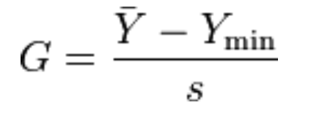
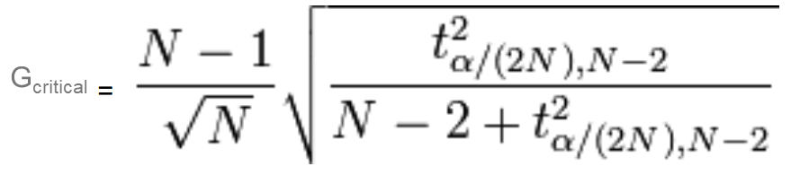
Grubbs' test
tα/(2N),N−2 is the upper critical value of a t-distribution
G_{test} < G_{critical}: keep the point in the data set; it is not an outlier.
G_{test} > G_{critical}: reject the point as an outlier.

Slide 19
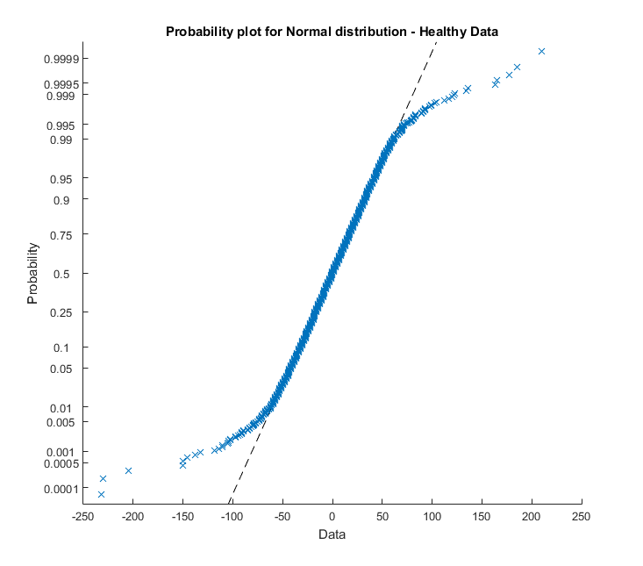
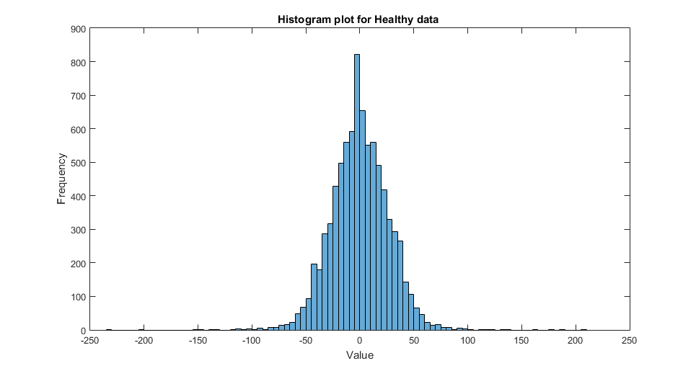
Healthy Data DISTRIBUTION – Before removing outliers
Outliers

Slide 20
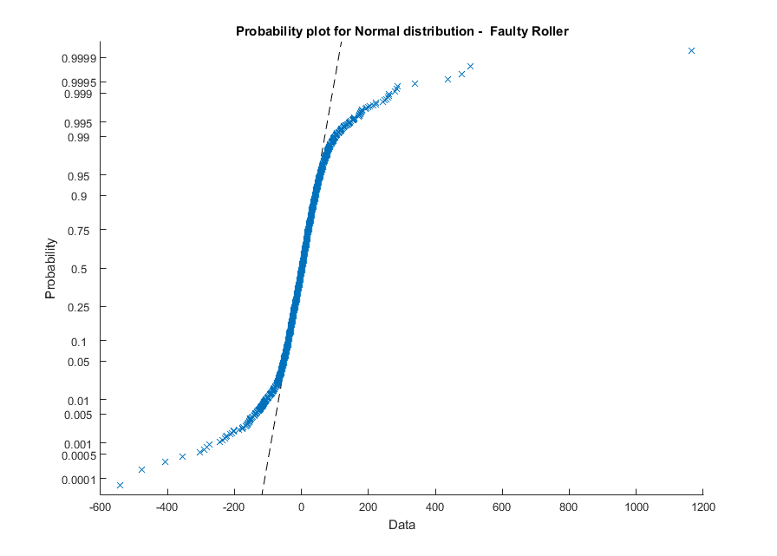
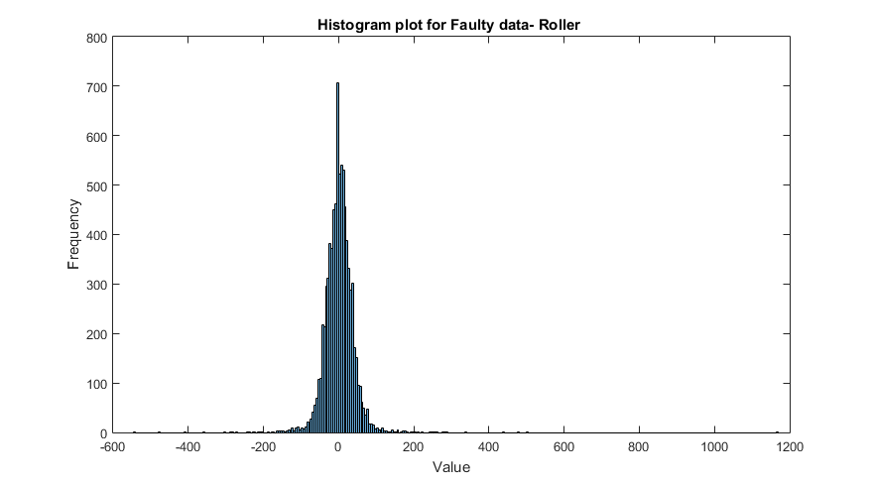
Faulty (Roller) Data DISTRIBUTION- Before removing outliers
Outliers

Slide 21
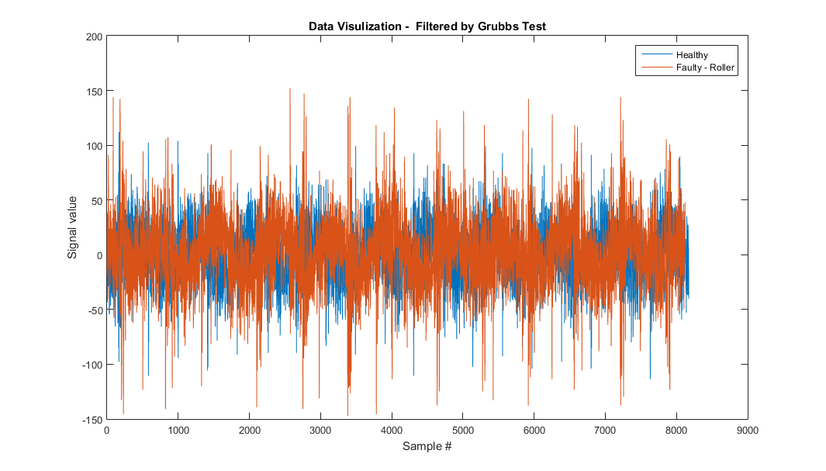
Grubbs' test - Results

Slide 22
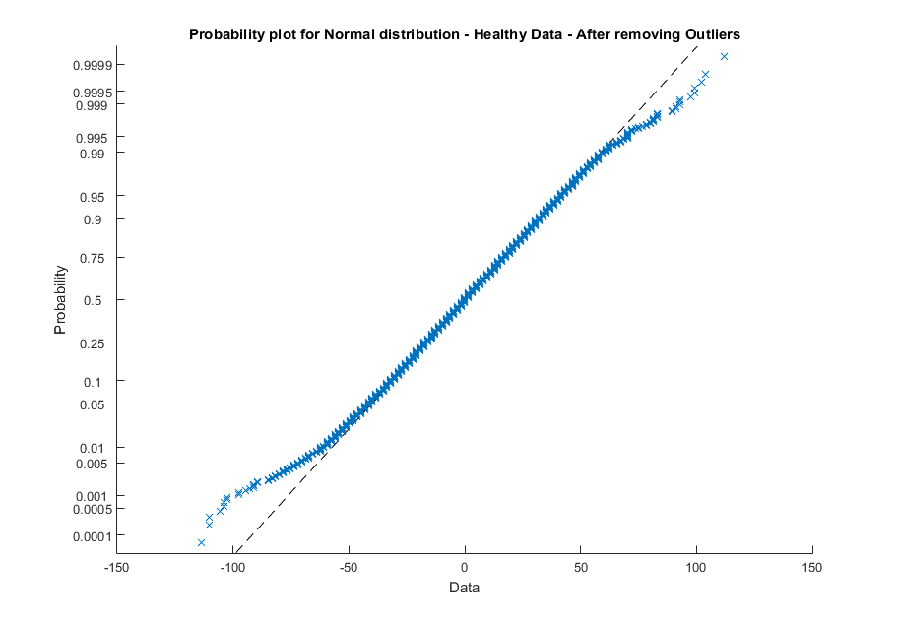
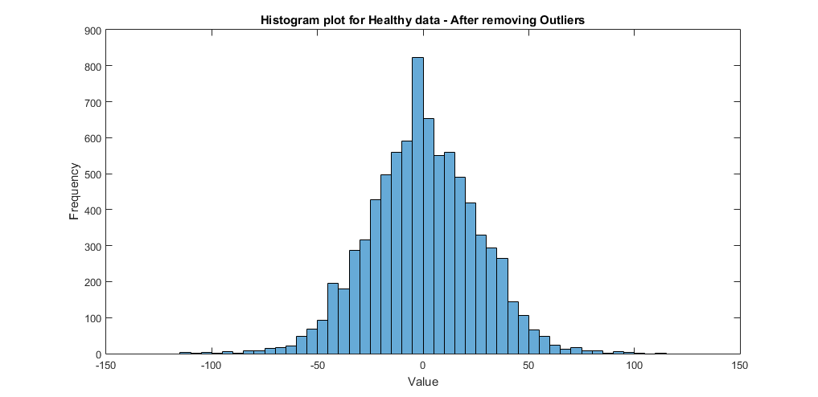
Healthy Data DISTRIBUTION – after removing outliers

Slide 23
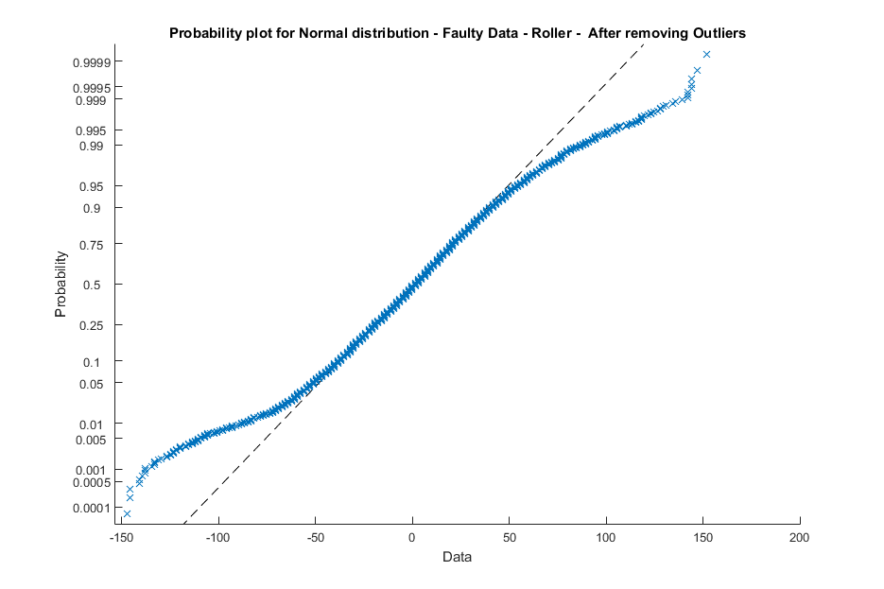
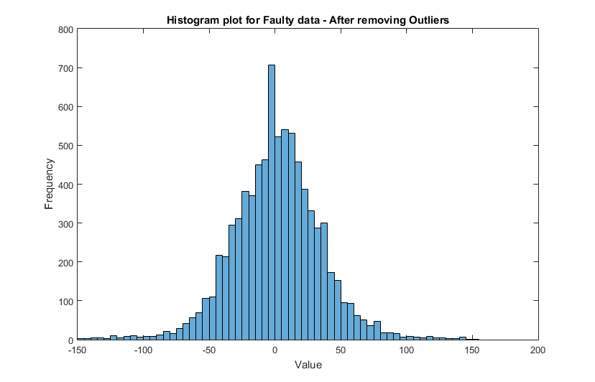
FAULTY Data DISTRIBUTION – after removing outliers

Slide 24
Outlier Removal – Moving window
By default, an outlier is a value that is more than three scaled median absolute deviations (MAD) away from the median.
A sliding window containing N elements is considered and a moving method is used for determining local outliers.
typically if a data is bigger than three local scaled MAD are considered as outliers.
No distribution limitation exists in this method.

Slide 25
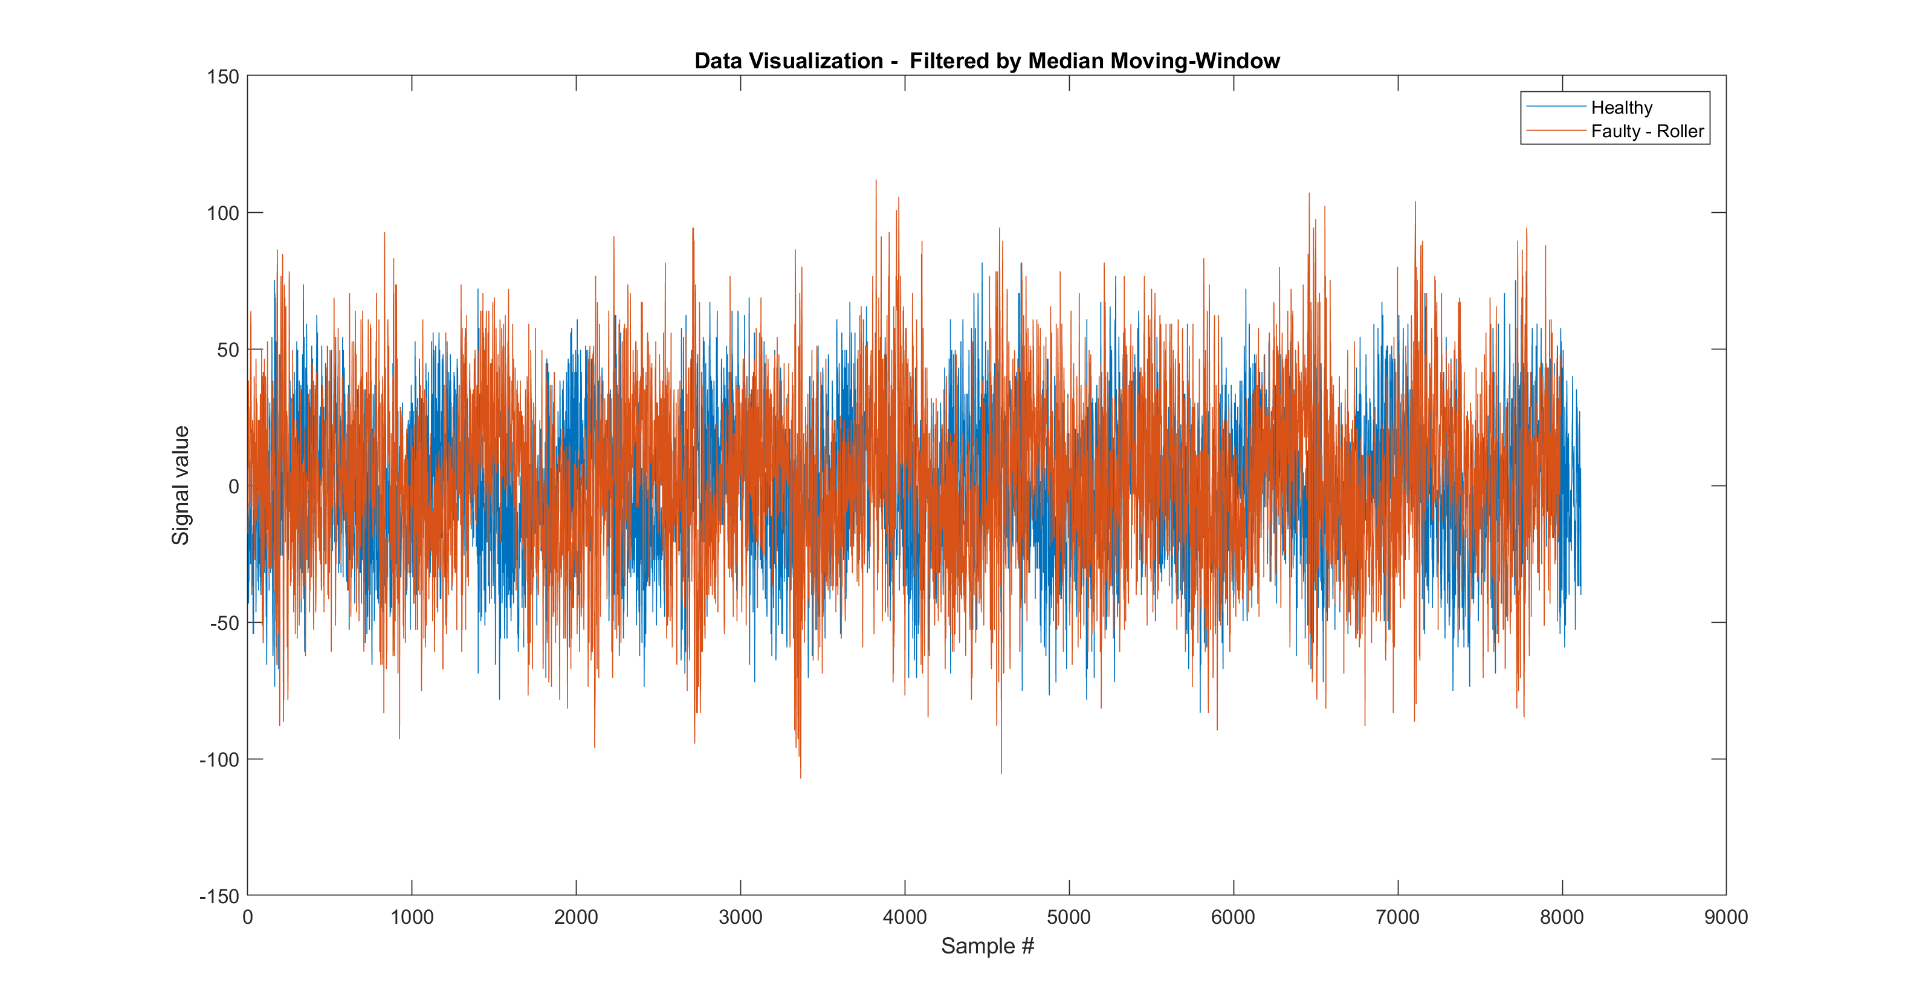
Moving window outlier removal test - results

Slide 26
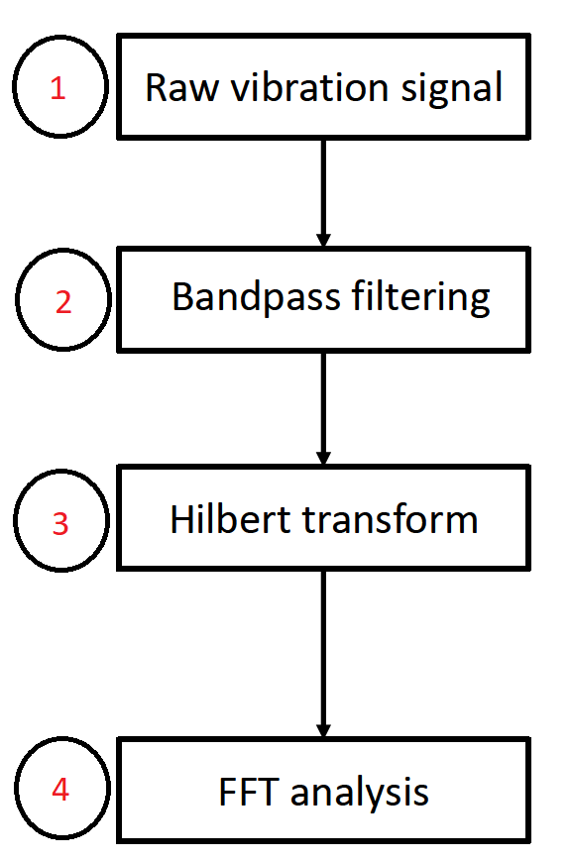
Envelope analysis on signal
1- Choosing a frequency range for filtering data- based on FFT or Spectral Kurtosis analysis
2- Band pass data around chosen frequency
3- Use Hilbert transform for finding upper edge of signal
4- Take FFT of signal signal

Slide 27
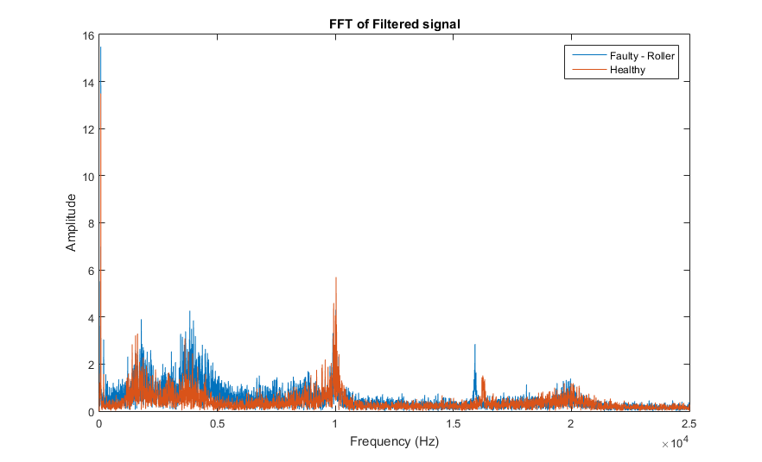
Fft of signals
Window selection plays an important role while doing BEA, selection of the poor window can lead to failure in detecting the fault bearing.
Proper EW selection can result in a CI (Condition Indicator of the bearing) that is sensitive to bearing fault.
Band Pass frequency

Slide 28
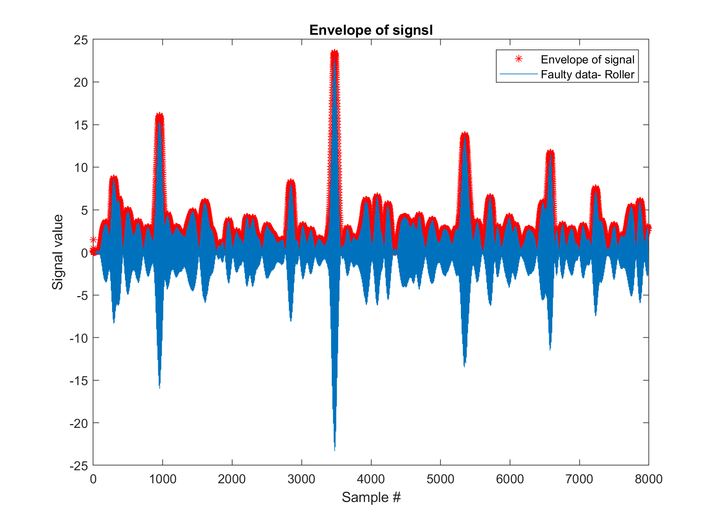
Envelope ANALYSIS of faulty signal

Slide 29
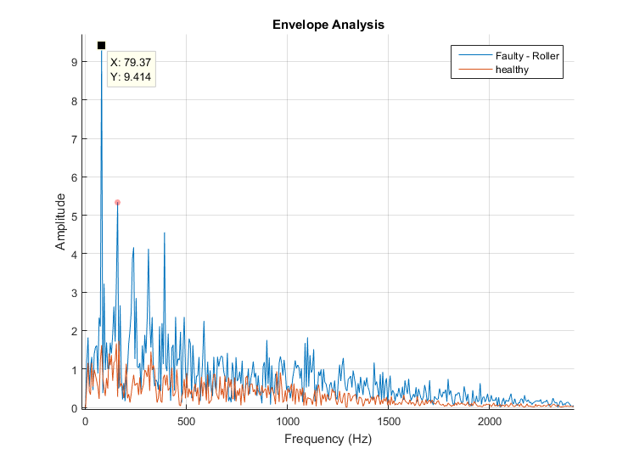
Envelope analysis of signal
As is observed, Roller frequency (77.65) and its harmonics are observed in the signal which indicate 100 % fault diagnosis.
Due to variation in the shaft frequency, we usually look for +/- 1.5 % around critical frequencies
BSF and its 3 harmonics

Slide 30
SPECTORAL KURTOSIS
Is a statistical tool which can indicate the presence of series of transients and their locations in the frequency domain.
Here we use this technique to find band path frequencies for filtering signal prior to using Envelop analysis.

Slide 31
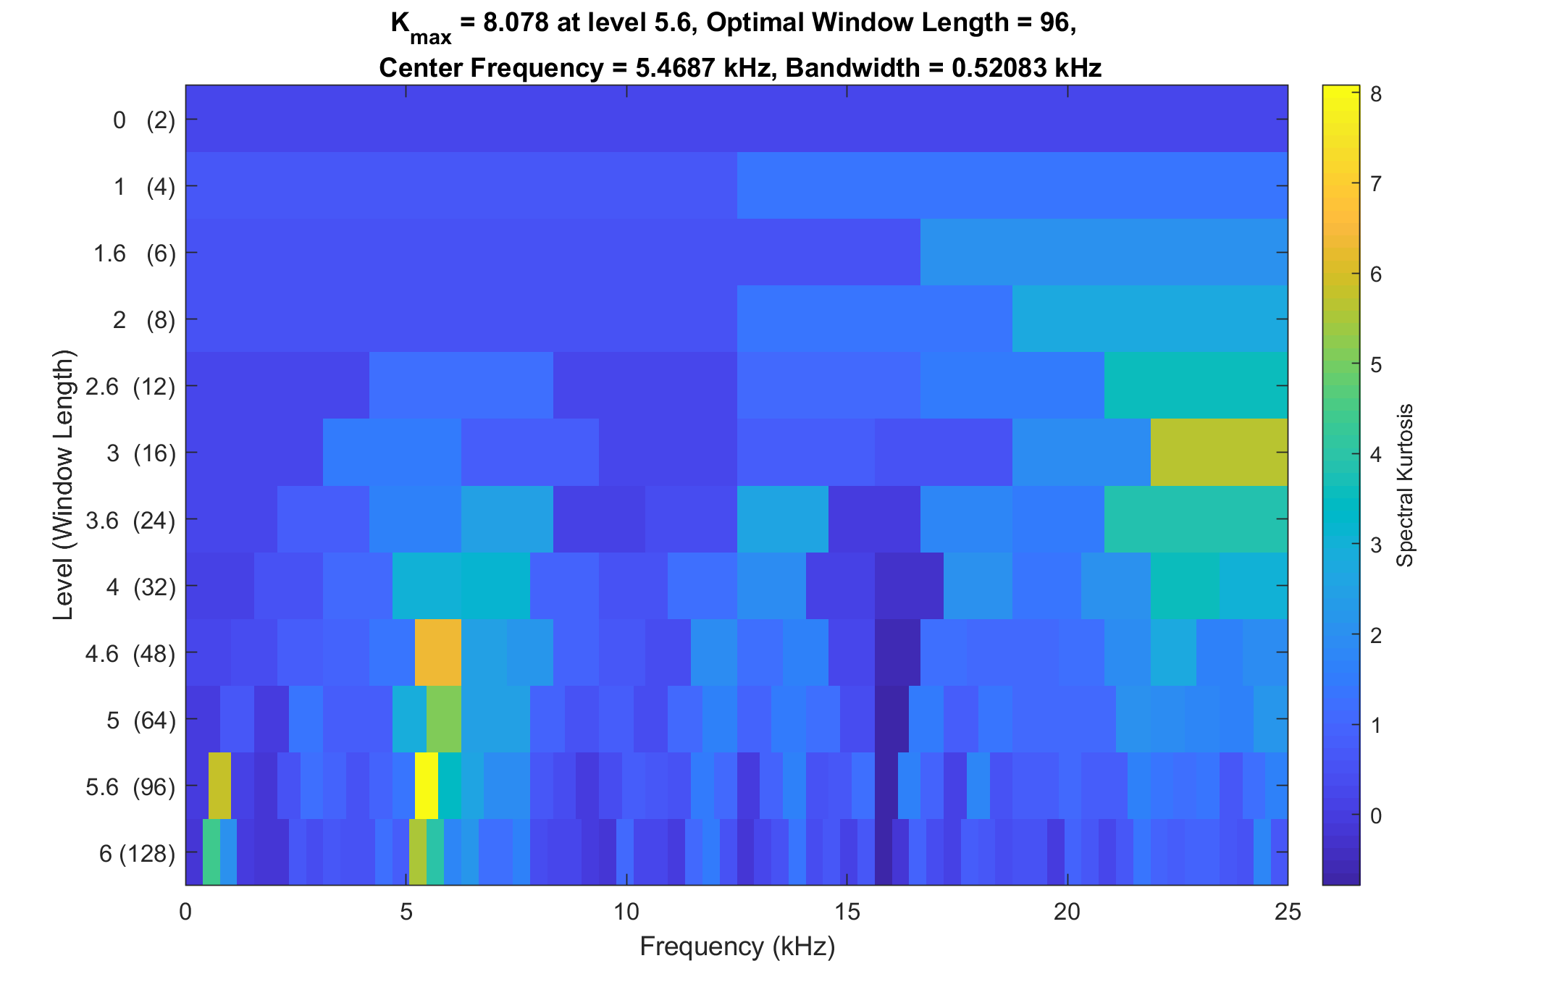
SPECTORAL KURTOSIS of faulty data
Faulty data is filtered around the frequency shown by yellow color.
Band Pass frequency

Slide 32
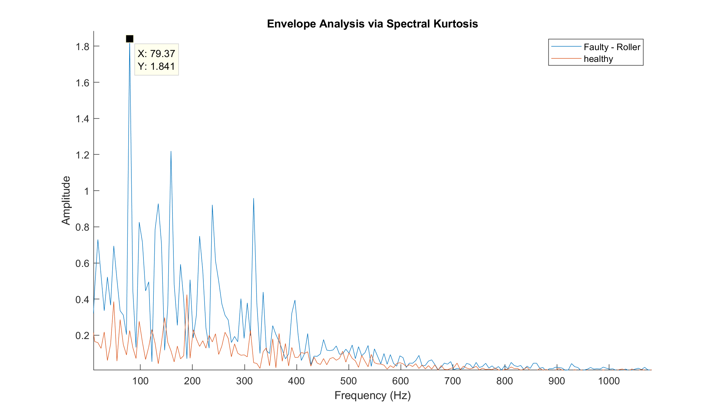
Envelope analysis VIA SPECTORAL KURTOSIS
As is observed, Roller frequency (77.65) and its harmonics are observed in the signal which indicate 100 % fault diagnosis.

Slide 33
Overview
Background study
Data Pre Processing
Data Visualization
Outlier Removal(Grubb’s Test, Moving Window)

Slide 34
Week progress
Implemented Kalman Filter for Data outlier removal
Feature Extraction
SVM analysis
Result comparison’s of different methods

Slide 35
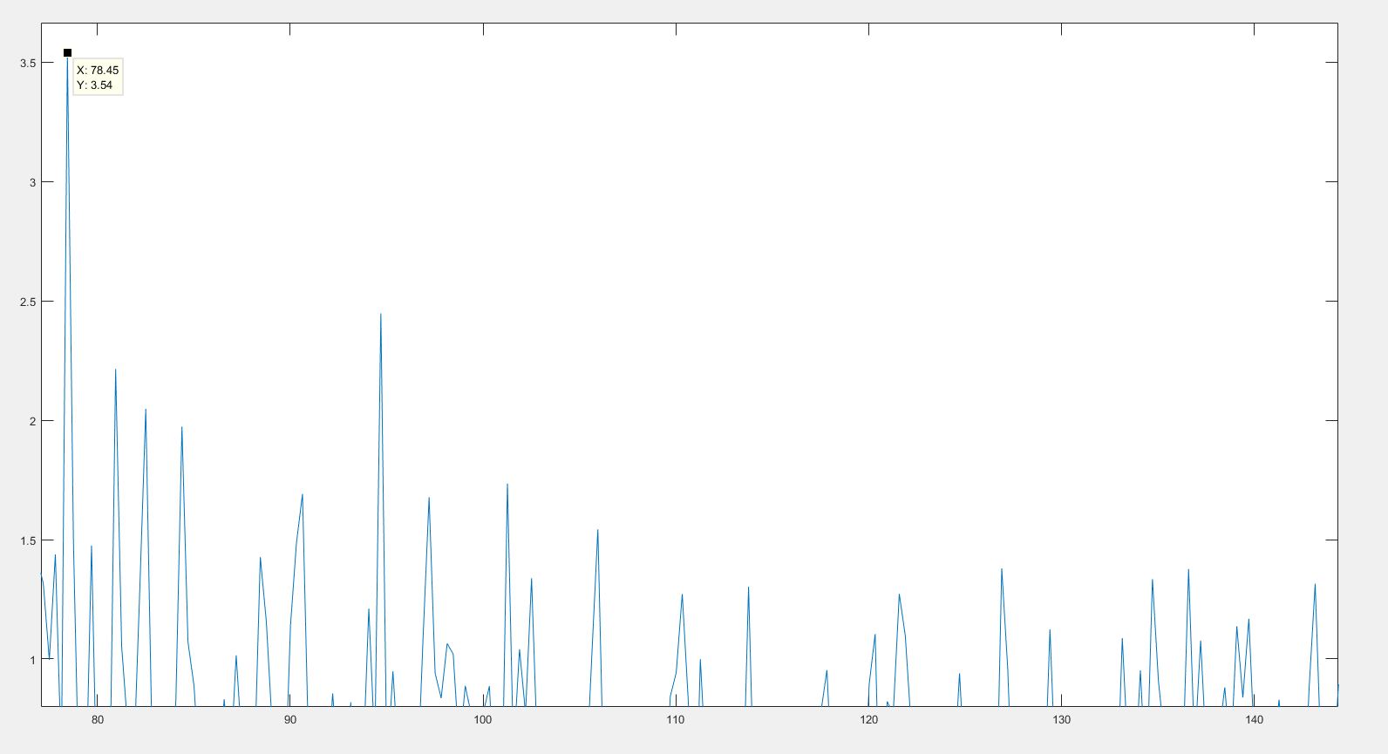
Feature extraction
Time domain: Mean, variance, skewness, kurtosis, RMS, peak2peak.
Frequency Domain: BSF, BPFI, BPFO (1st, 2nd, 3rd harmonics)
BSF
BPFI

Slide 36
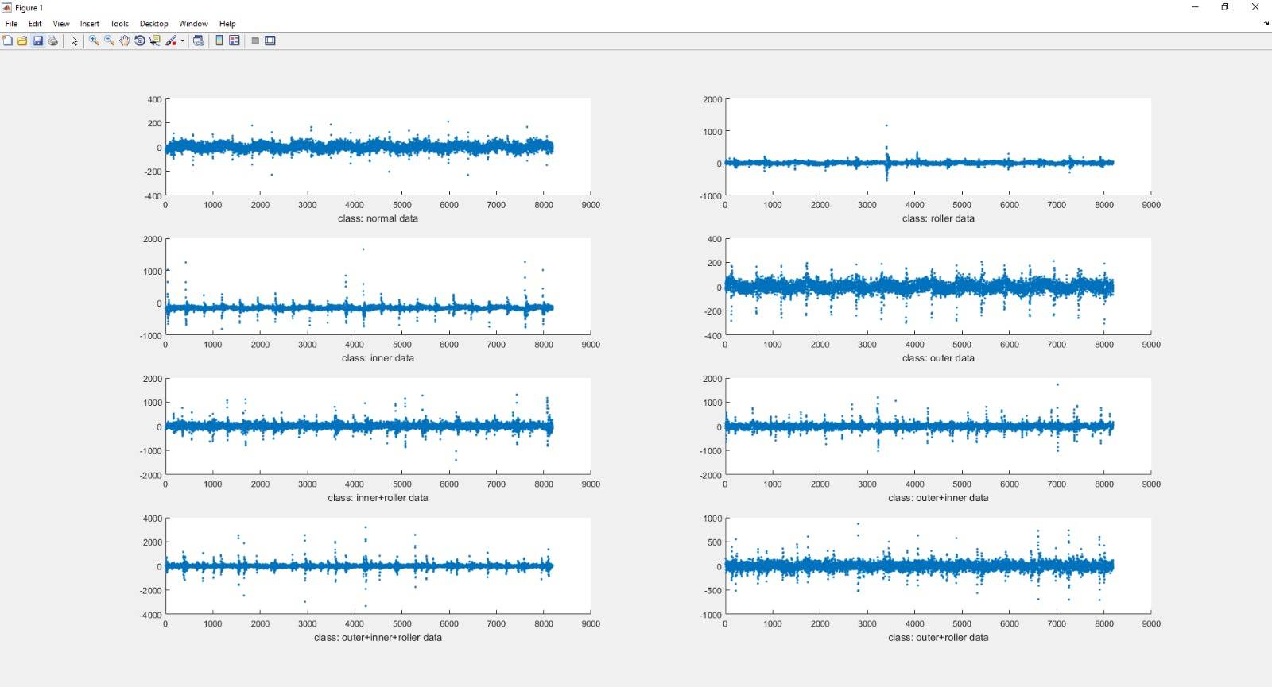
Original data

Slide 37
Svm
Do SVM for 8 classes separately and try to predict the class of the test data which will show whether the data is healthy or faulty and will tell the class of the data.
Radial Basis Function used for SVM.
Cross validation
Split the Training data into 75% and 25% and train with 75% and test with the remaining 25% of data.
We plot confusion matrix for evaluation of the model.

Slide 38
Moving window
By default, an outlier is a value that is more than three scaled median absolute deviations (MAD) away from the median.
A sliding window containing N elements is considered and a moving method is used for determining local outliers.
typically if a data is bigger than three local scaled MAD are considered as outliers.
No distribution limitation exists in this method.

Slide 39
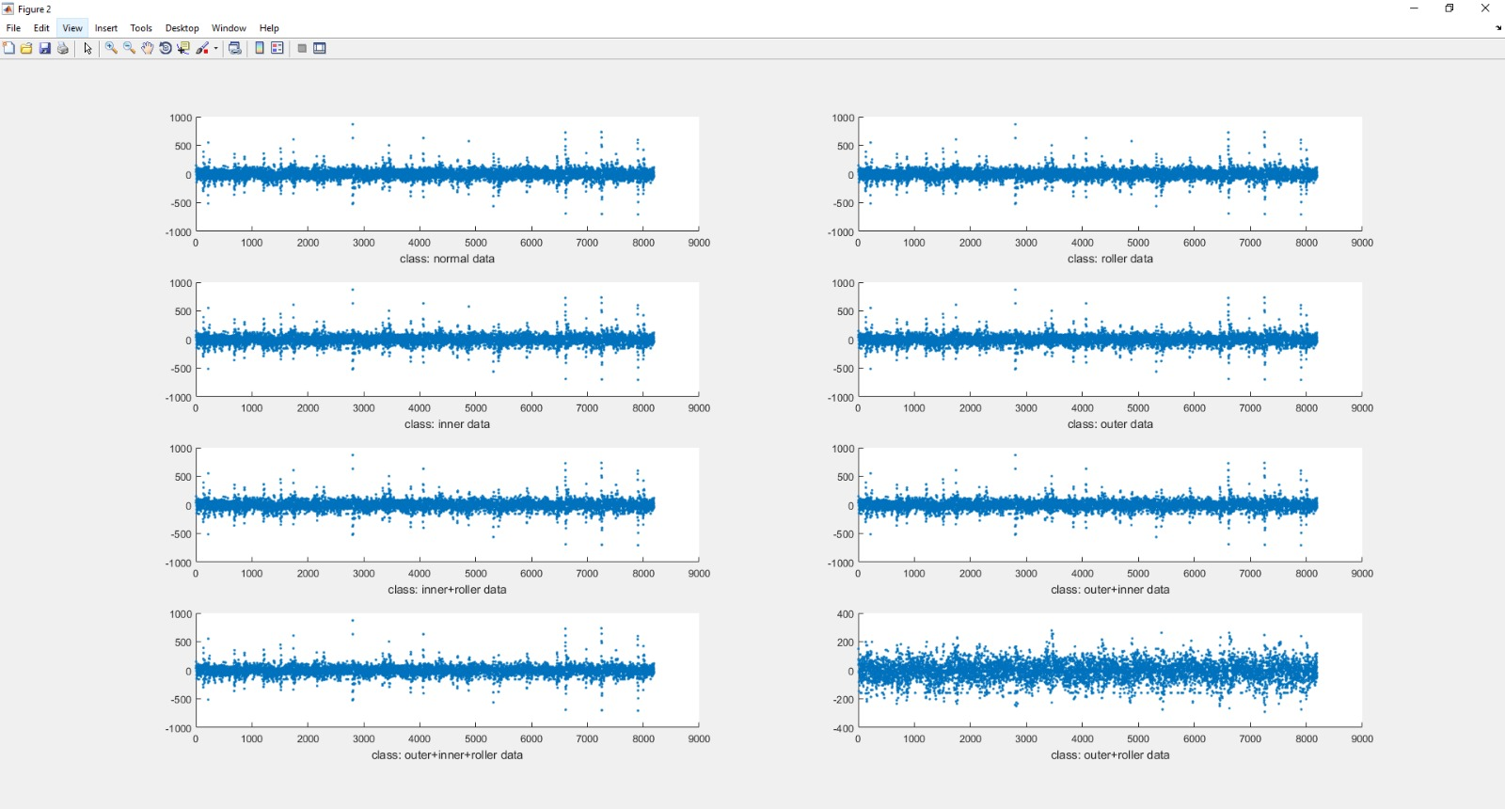
Moving window

Slide 40
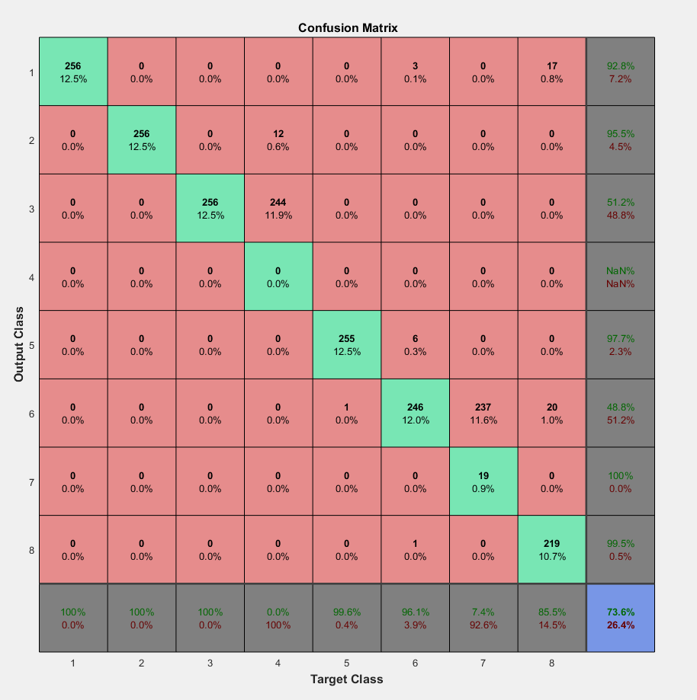
Moving window

Slide 41
Kalman filter
Linear quadratic estimator
Efficient in reducing Gaussian noise especially sensor measurements
Prediction of states and updating of measurements
Commonly used in guidance, navigation and automatic control

Slide 42
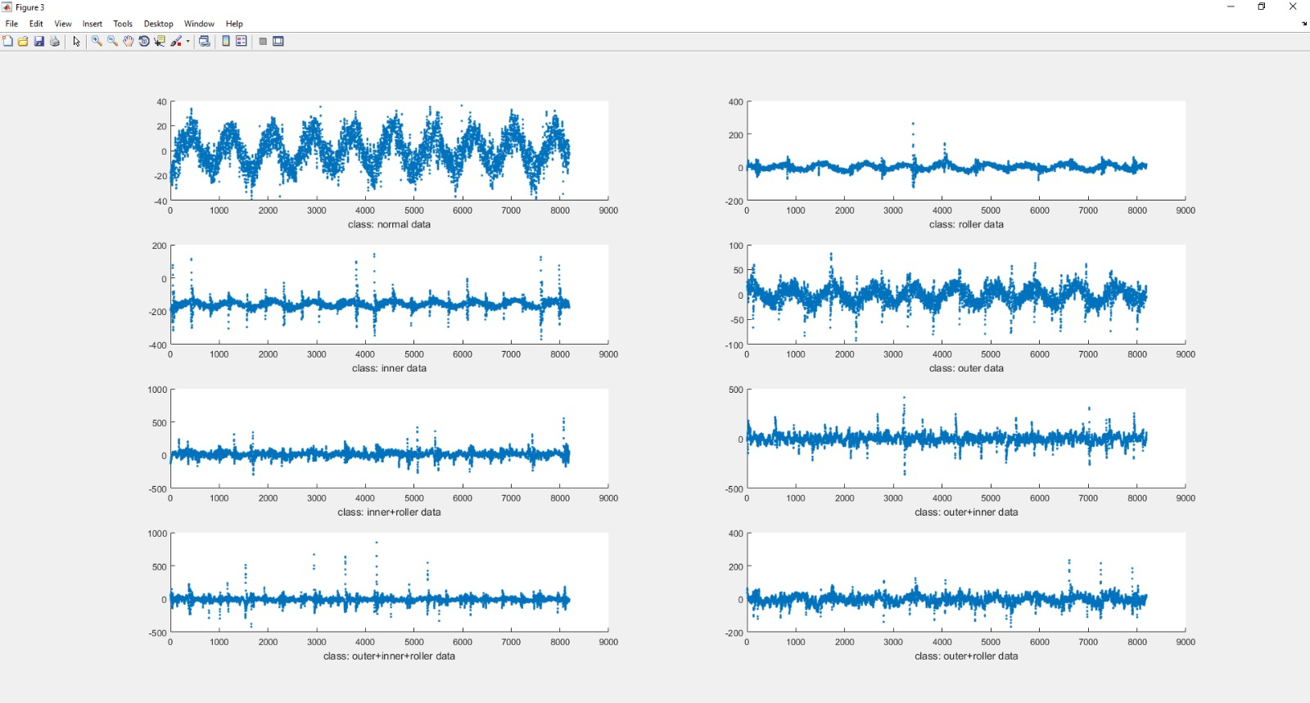
Kalman filter result

Slide 43
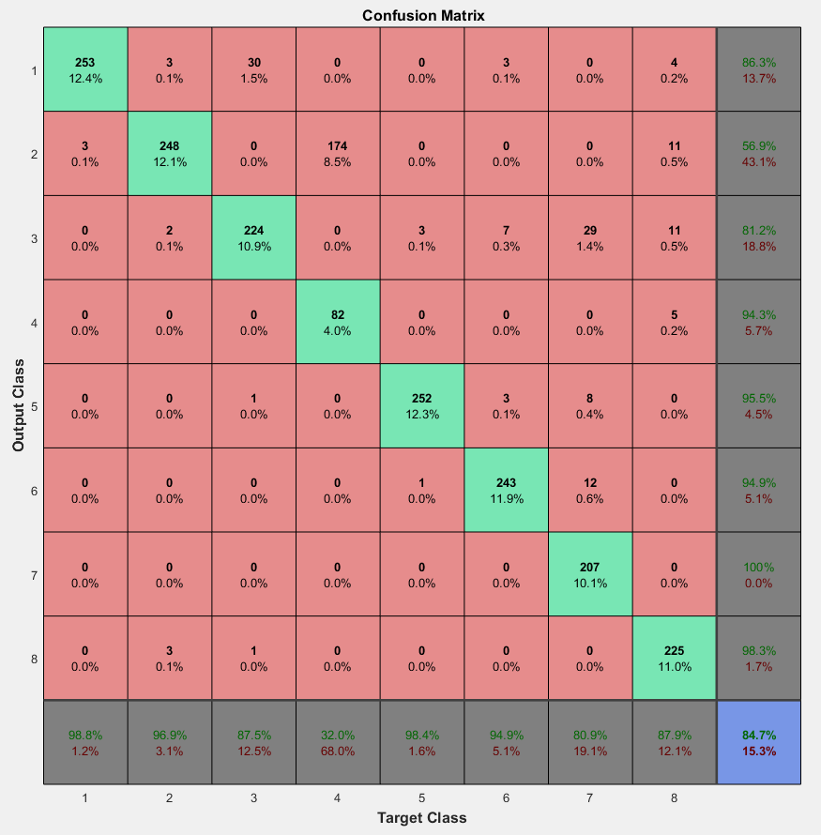
Kalman filter result

Slide 44
Combining both kalman and moving window
FISHER CRITERIA SCORE FOR THE TRAINING SAMPLES
CLASS 1 | 4 | 2
CLASS 2 | 8 | 9
CLASS 3 | 5 | 10
CLASS 4 | 2 | 6
CLASS 5 | 11 | 7
CLASS 6 | 2 | 6
CLASS 7 | 8 | 4
CLASS 8 | 7 | 4

Slide 45
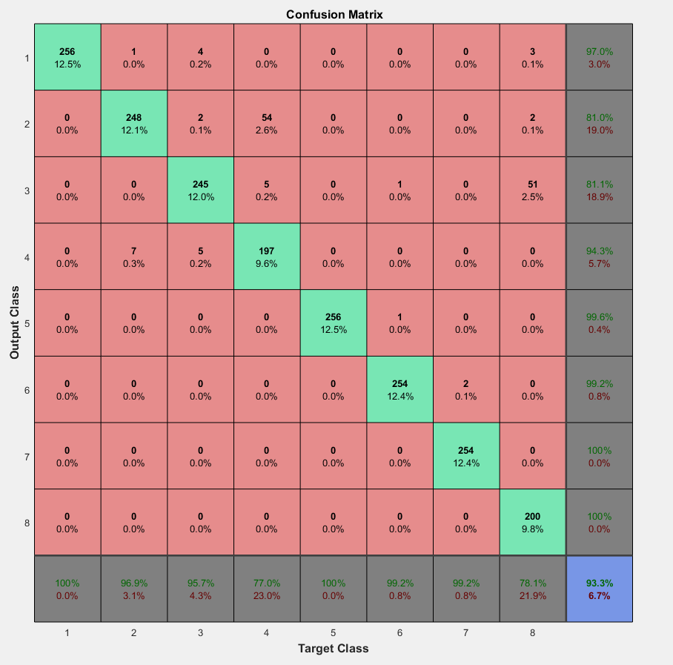
Combining both kalman and moving window
KALMAN FILTER RESULT
COMBINED RESULT

Slide 46
Next week
K-fold validation.
Boosting and Bagging
Report writing

